Slide 1
Developing Apps for Touch and Mobile Devices

Slide 2
Objectives
In this session, you will learn to:
  Monetize an app
  Publish an app
  Analyze an app

Slide 3
Advertising in an Android App

Slide 4
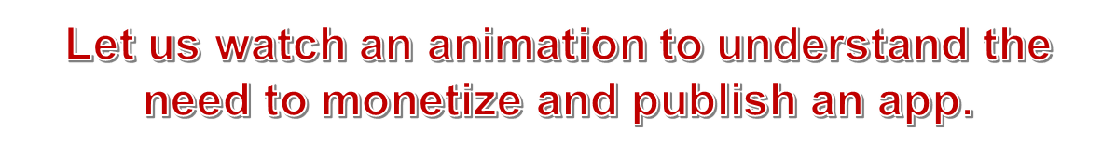
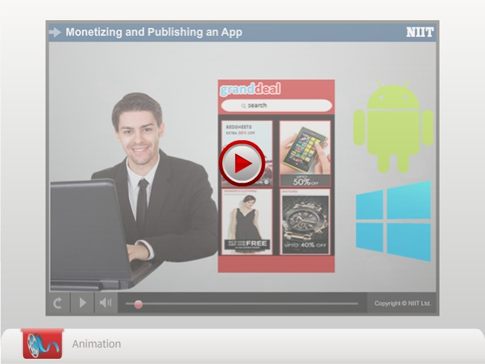
Advertising in a Windows App

Slide 5
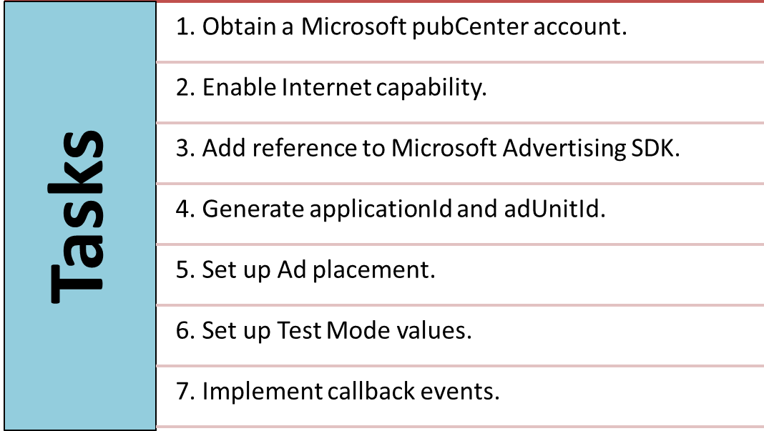
Advertising in a Windows App (Contd.)
To advertise through Ads provided by Microsoft pubCenter, you need to perform the following tasks:

Slide 6
Advertising in a Windows App (Contd.)
The following table shows some of the callback events with their description.
Event | Description
onAdRefreshed | Executes when the AdControl receives a new Ad
onErrorOccured | Executes when the AdControl encounters an operational error
onEngageChanged | Executes when the user clicks the Ad
onPointerDown | Executes when the user clicks, points, or touches an AdControl
onPointerUp | Executes when user stops clicking, pointing, or touching an AdControl
Callback Events

Slide 7

Task 12.9: Obtaining a Microsoft pubCenter Account

Slide 8
Task 12.10: Enabling the Internet Capability

Slide 9

Task 12.11: Adding Reference to Microsoft Advertising SDK

Slide 10
Task 12.12: Generating applicationId and adUnitId

Slide 11
Task 12.13: Setting up Ad Placements

Slide 12
Task 12.14: Setting up Test Model Values

Slide 13
Task 12.15: Implementing Callback Events

Slide 14
Activity 12.2: Implementing Ads in a Windows App
Problem Statement:
John has created a login screen in the Windows App he is developing. Now, he is planning to implement Ads on this screen before publishing it to the store. He has planned to place an Ad of size 728x90 pixels at the bottom of the screen. Help John to place Ads in the App.
Solution:
To complete this activity, you need to perform the following steps:
  Enable the Internet capability.
  Add reference to Microsoft Advertising SDK.
  Generate applicationId and adUnitId.
  Set up Ad placements.
  Implement callback events.
  Execute the app and verify the output.

Slide 15
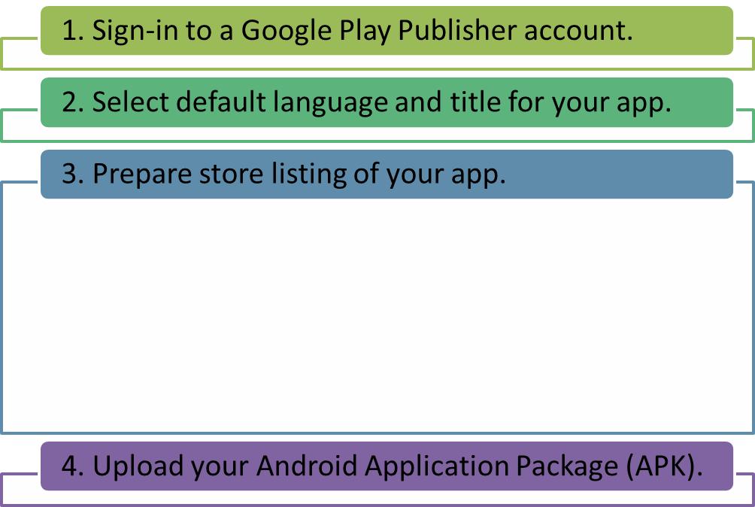
Publishing an Android App on Google Play Store
To publish an Android app on Google Play Store, you need to perform the following steps:
This step further consists of following steps:
Create a short description of your app.
Create a full description of your app.
Upload the various graphic assets.
Categorize your app.
Provide contact details.
Update privacy policy of your app.

Slide 16

Task 12.16: Publishing an Android App

Slide 17
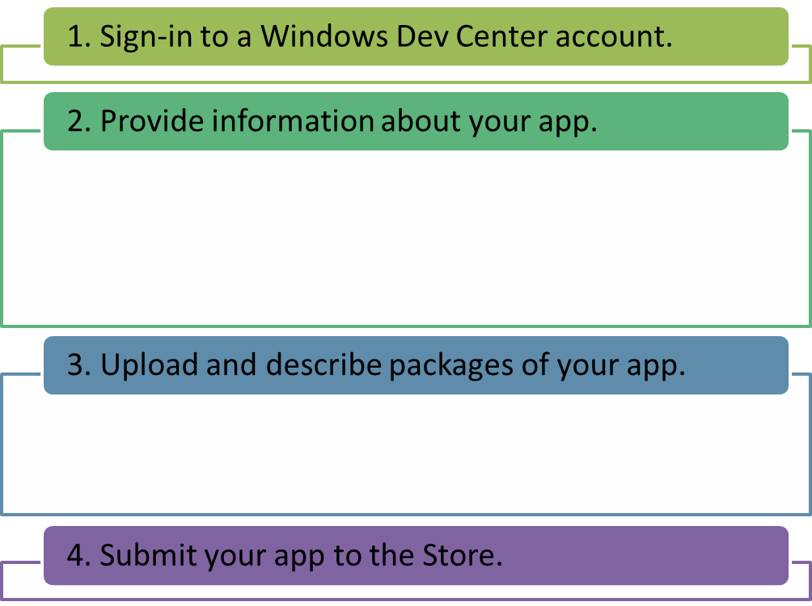
Publishing a Windows Phone App on Windows Phone Store
To publish a Windows Phone app to Windows Phone store, you need to have a Windows Dev Center account.
To publish a Windows Phone app, you need to perform the following steps:
This step further consists of following steps:
Select and reserve your app name.
Determine category of your app.
Select the pricing of your app.
Select the market distribution of your app.
You also need to upload the various components of the Store listings, such as app tile, background image, and screenshots.

Slide 18
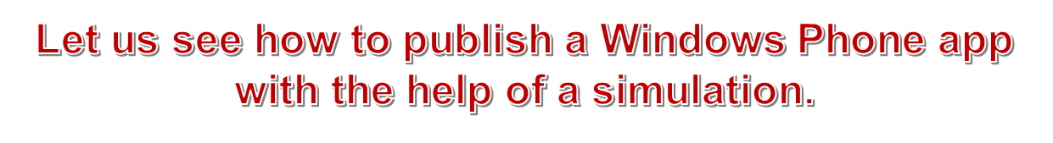
Task 12.17: Publishing a Windows Phone App

Slide 19
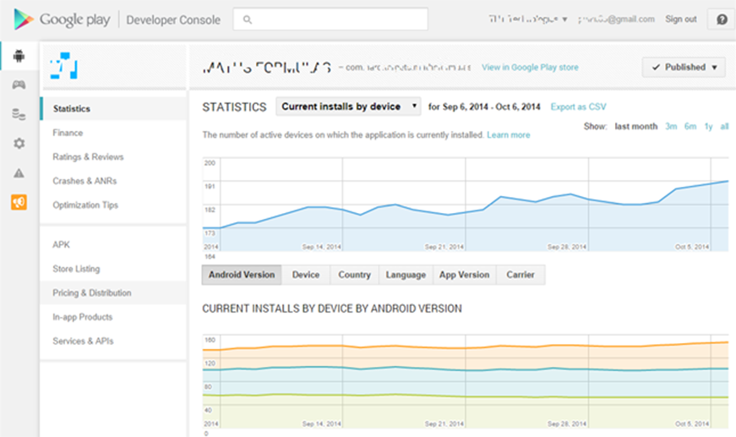
Analyzing an Android App
You can use the Google Play Developer Console to view the status of your apps and analyze them in detail.
The following figure shows Google Play Developer Console for an app.

Slide 20
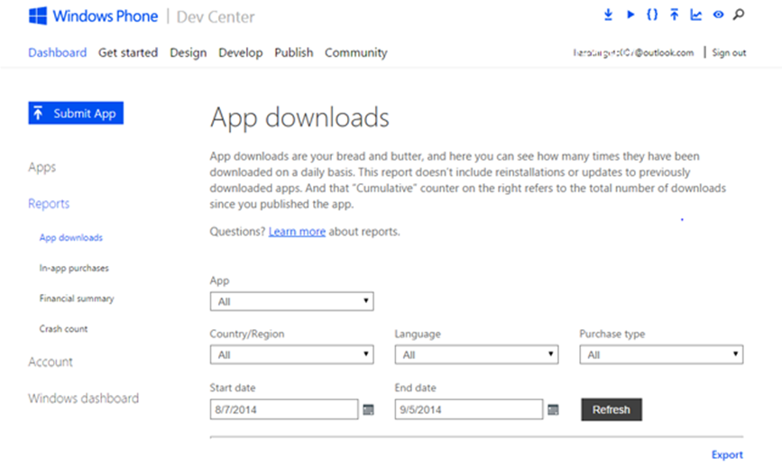
Analyzing a Windows Phone App
In Windows Phone Store Dashboard, you can view the status of your apps and analyze them in greater detail under the Reports tab.
The following figure shows Reports screen in Windows Phone Dev Center.

Slide 21

Just a Minute
Which one of the following pages in the Reports screen lets you assess the quality of your app?
App downloads
In-app purchases
Financial summary
Crash count
Answer:
Crash count

Slide 22
Summary
In this session, I learned that:

